Slide 1
MORE on ANTENARRATIVE METHODOLOGY
David M. Boje

Slide 2
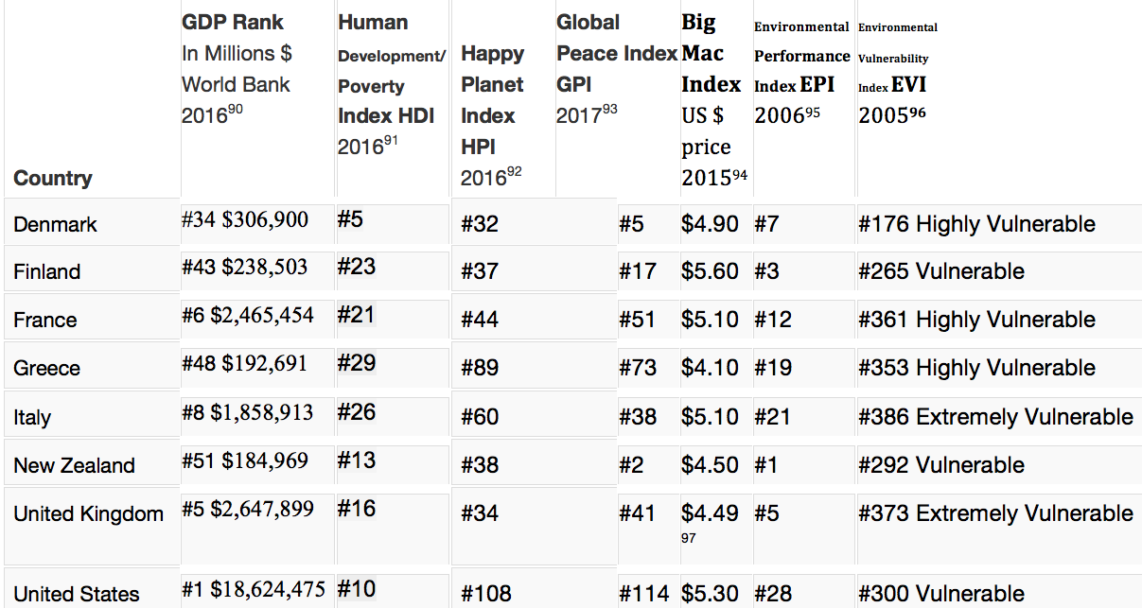
Boje’s World Tour of Globalization Storytelling

Slide 3
GDP is not measure of anything relevant to ecology
The GDP rankings of nations is “ecologically irrelevant, since they do not account for the possible absolute increases in material flows from the ecosphere to the economy” (Milne & Gray, 2013: 23).

Slide 4
Finland’s Co-operative Business
Finland, along with most other Nordic countries, has a very strong co-operative business sector. Over 20% of Finland’s GDP comes from co-operative enterprise.
As neo-liberalism becomes more and more discredited, co-operatives and mutuals are being increasingly seen as the way forward
Notes:
https://www.theguardian.com/commentisfree/2018/mar/25/left-liberal-capitalism-globalisation-poverty

Slide 5
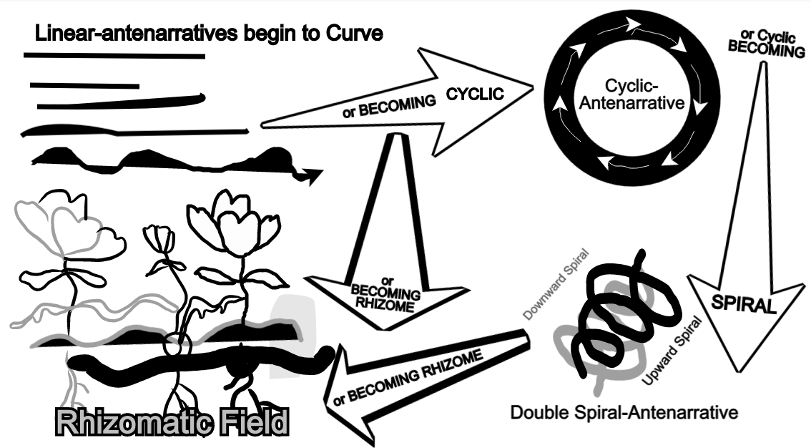
2011
Antenarrative Handbook

Slide 6
2013 – another top tier break
Rosile, G. A., Boje, D. M., Carlon, D. M., Downs, A., & Saylors, R. (2013). Storytelling diamond: An antenarrative integration of the six facets of storytelling in organization research design. Organizational Research Methods, 16(4), 557-580.

Slide 7
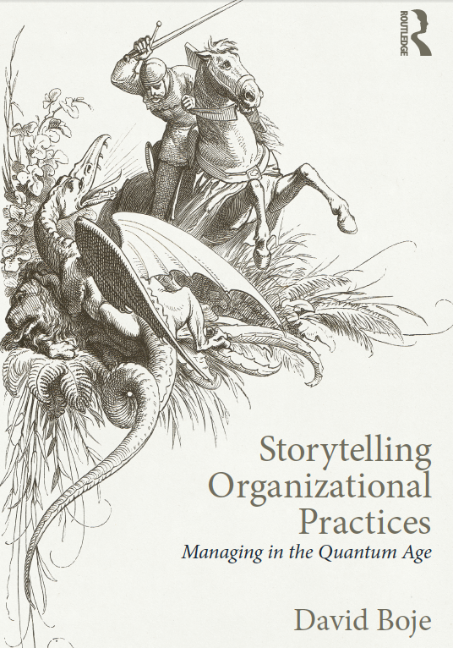
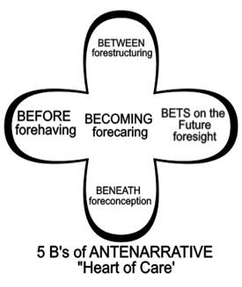
Boje 2014

Slide 8
2014 – more top tier exposure
Haley, Usha CV, and David M. Boje. "Storytelling the internationalization of the multinational enterprise." Journal of International Business Studies 45, no. 9 (2014): 1115-1132.

Slide 9
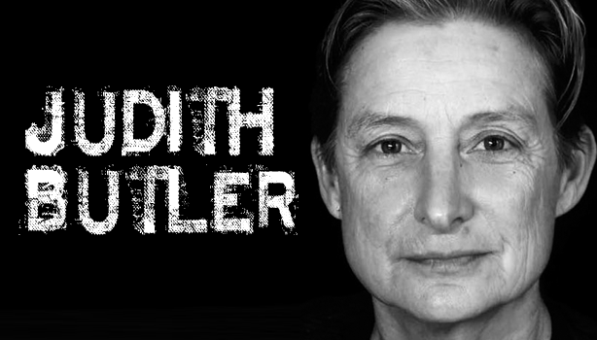
2016 – Judith Butler’s Anti-narrative meets Antenarrative
Riach, K., Rumens, N., & Tyler, M. (2016). Towards a Butlerian methodology: Undoing organizational performativity through anti-narrative research. Human Relations, 69(11), 2069-2089.

Slide 10
What Antenarrative & Anti-narrative share
“Our anti-narrative approach therefore seeks to disrupt the apparent linearity, stability and coherence of organizational performances by ‘undoing’ (Butler, 2004) seemingly coherent subjectivities as a methodologically reflexive move” (Riach, Rumens, & Tyler, 2016)
Anti-narrative and antenarrative do share this in common: both are beyond the closure required of narrative theory” (Boje, 2001: 3)

Slide 11
2017 – more dissemination
Stierand, M., Boje, D. M., Glăveanu, V., Dörfler, V., Haley, U. C., & Feuls, M. (2017). Paradoxes of “creativity”: Examining the creative process through an antenarrative lens. The Journal of Creative Behavior.

Slide 12
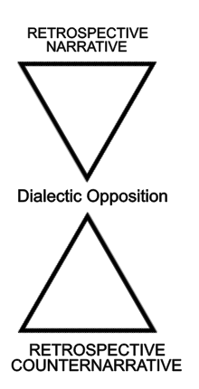
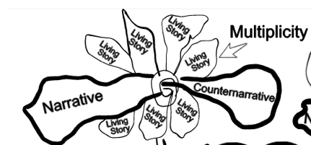
2 dialectics

Slide 13
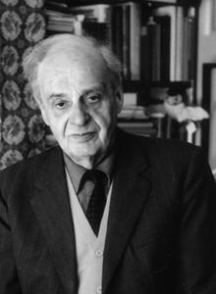
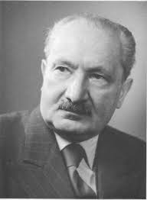
Henrich, Dieter. (1973/2003). Between Kant and Hegel, edited by David S. Pacini in 1973. Published 2003. Cambridge, MA: Harvard University Press.
Henrich (2003: 316) explains the negation of negation dialectic as Hegel’s conception of the notion of ‘life’ Hegel wants to arrive at point where “negation of negation is not having negation” at all (318).
By contract, for Heidegger, negation of negation dialectic is a notion of forecaring in advance of good conscience, where a evil forecaring is always a potentiality.

